Slide 1
Guide to Programming with Python
Chapter Nine
Object-Oriented Programming: The Blackjack Game

Slide 2
Objectives
Create objects of different classes in the same program
Allow objects to communicate with each other
Create more complex objects by combining simpler ones
Derive new classes from existing ones
Extend the definition of existing classes
Override method definitions of existing classes

Slide 3
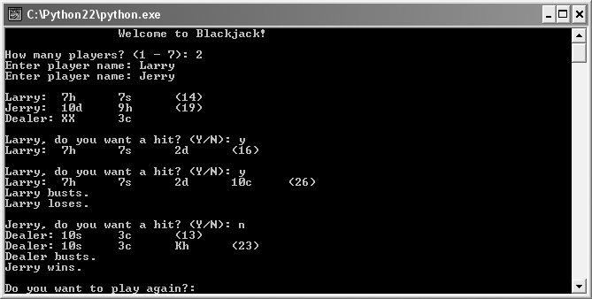
The Blackjack Game
Figure 9.1: Sample run of the Blackjack game
One player wins, the other is not so lucky.

Slide 4
Sending and Receiving Messages
Object-oriented program like an ecosystem
Objects like organisms
Organisms interact and so do objects
Message: Communication between objects; one object sends another a message when it invokes a method of the other

Slide 5
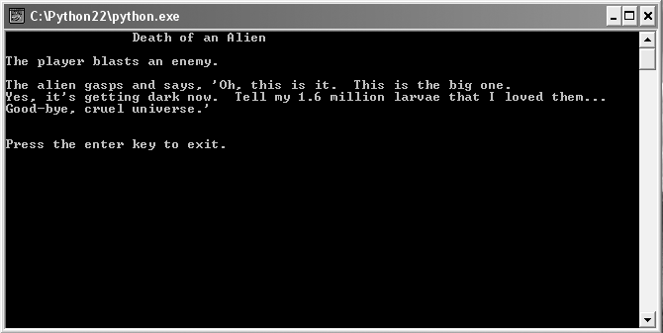
The Alien Blaster Program
Figure 9.2: Sample run of the Alien Blaster program
Battle description is result of objects exchanging message.

Slide 6
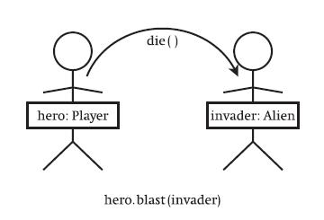
The Alien Blaster Program (continued)
Figure 9.3: Visual representation of objects exchanging a message
hero, a Player object, sends invader, an Alien object, a message.

Slide 7
The Alien Blaster Program (continued)
class Player(object):
def blast(self, enemy):
print "The player blasts an enemy."
enemy.die()
class Alien(object):
def die(self):
print "Good-bye, cruel universe."
hero = Player()
invader = Alien()
hero.blast(invader)

Slide 8
Sending a Message
class Player(object):
def blast(self, enemy):
print "The player blasts an enemy."
enemy.die()
...
hero.blast(invader)
hero blast() method passed invader
(i.e. Player blast() method passed Alien object)
In blast(), enemy refers to the Alien object
blast() invokes the Alien object’s die() method
(i.e. Player object sends Alien object message)

Slide 9
Combining Objects
Real-world objects often made up of other objects
Can mimic composition and collection in OOP
Drag racer composed of body, tires, and engine
Drag_Racer class with attribute engine that references Race_Engine object
Zoo is collection of animals
Zoo class that has an attribute animals which is a list of different Animal objects

Slide 10
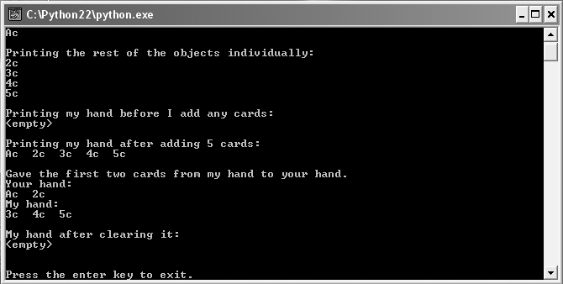
The Playing Cards Program
Figure 9.4: Sample run of the Playing Cards program
Each Hand object has a collection of Card objects.

Slide 11
Creating the Card Class
class Card(object):
""" A playing card. """
RANKS = ["A", "2", "3", "4", "5", "6", "7",
"8", "9", "10", "J", "Q", "K"]
SUITS = ["c", "d", "h", "s"]
def __init__(self, rank, suit):
self.rank = rank
self.suit = suit
def __str__(self):
rep = self.rank + self.suit
return rep

Slide 12
Creating the Card Class (continued)
Card object rank attribute represents rank of card
RANKS class attribute has all possible values
"A" ace, "J" jack, "Q" queen, "K" king, "2" - "10" numeric values
Card object suit attribute represents suit of card
SUITS class attribute has all possible values
"c" clubs, "d" diamonds, "h" hearts, "s" spades
Object rank "A" and suit "d" is ace of diamonds

Slide 13
Creating the Hand Class
class Hand(object):
""" A hand of playing cards. """
def __init__(self):
self.cards = []
def __str__(self):
if self.cards:
rep = ""
for card in self.cards:
rep += str(card) + " "
else:
rep = "<empty>"
return rep

Slide 14
Creating the Hand Class (continued)
def clear(self):
self.cards = []
def add(self, card):
self.cards.append(card)
def give(self, card, other_hand):
self.cards.remove(card)
other_hand.add(card)

Slide 15
Creating the Hand Class (continued)
Attribute
cards is list of Card objects
Methods
__str__() returns string for entire hand
clear() clears list of cards
add() adds card to list of cards
give() removes card from current hand and adds to another hand

Slide 16
Using Card Objects
card1 = Card(rank = "A", suit = "c")
card2 = Card(rank = "2", suit = "c")
card3 = Card(rank = "3", suit = "c")
card4 = Card(rank = "4", suit = "c")
card5 = Card(rank = "5", suit = "c")
print card1 # Ac
print card2 # 2c
print card3 # 3c
print card4 # 4c
print card5 # 5c

Slide 17
Combining Card Objects Using a Hand Object
my_hand = Hand()
print my_hand # <empty>
my_hand.add(card1)
my_hand.add(card2)
my_hand.add(card3)
my_hand.add(card4)
my_hand.add(card5)
print my_hand # Ac 2c 3c 4c 5c

Slide 18
Combining Card Objects Using a Hand Object (continued)
your_hand = Hand()
my_hand.give(card1, your_hand)
my_hand.give(card2, your_hand)
print your_hand # Ac 2c
print my_hand # 3c 4c 5c
my_hand.clear()
print my_hand # <empty>

Slide 19
Using Inheritance to Create New Classes
Inheritance: An element of OOP that allows a new class to be based on an existing one where the new automatically gets (or inherits) all of the methods and attributes of the existing class
Like getting all work that went into existing class for free

Slide 20
Extending a Class Through Inheritance
Inheritance used to create more specialized version of existing class
New class gets all methods and attributes of existing class
New class can also define additional methods and attributes
Drag_Racer class with methods stop() and go()
Clean_Drag_Racer based on Drag_Racer()
Automatically inherits stop() and go()
Can define new method, clean(), for cleaning windshield

Slide 21
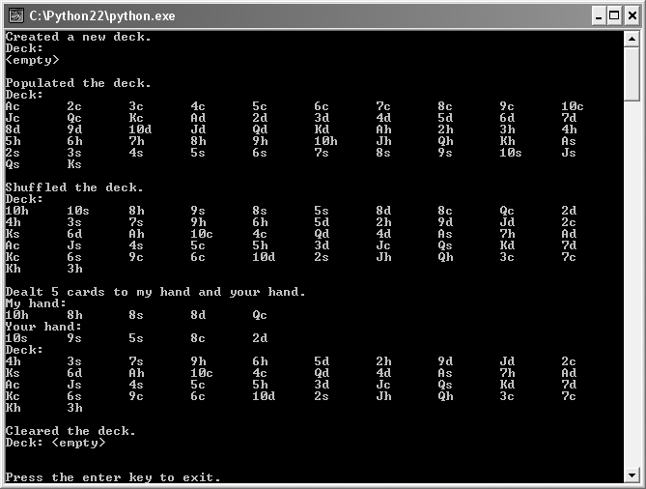
The Playing Cards 2.0 Program
Figure 9.5: Sample run of the Playing Cards 2.0 program
The Deck object inherits all of the methods of the Hand class.

Slide 22
Creating a Base Class
(Same as before)
class Hand(object):
""" A hand of playing cards. """
def __init__(self):
self.cards = []
def __str__(self):
if self.cards:
rep = ""
for card in self.cards:
rep += str(card) + " "
else:
rep = "<empty>"
return rep

Slide 23
Creating a Base Class (continued)
(Same as before)
def clear(self):
self.cards = []
def add(self, card):
self.cards.append(card)
def give(self, card, other_hand):
self.cards.remove(card)
other_hand.add(card)

Slide 24
Inheriting from a Base Class
class Deck(Hand):
Base class: A class upon which another is based; it is inherited from by a derived class
Derived class: A class that is based upon another class; it inherits from a base class
Hand is base class
Deck is derived class

Slide 25
Inheriting from a Base Class (continued)
Deck inherits Hand attribute:
cards
Deck inherits all Hand methods:
__init__()
__str__()
clear()
add()
give()

Slide 26
Extending a Derived Class
class Deck(Hand):
""" A deck of playing cards. """
def populate(self):
for suit in Card.SUITS:
for rank in Card.RANKS:
self.add(Card(rank, suit))
def shuffle(self):
import random
random.shuffle(self.cards)

Slide 27
Extending a Derived Class (continued)
def deal(self, hands, per_hand = 1):
for rounds in range(per_hand):
for hand in hands:
if self.cards:
top_card = self.cards[0]
self.give(top_card, hand)
else:
print "Out of cards!"

Slide 28
Extending a Derived Class (continued)
In addition to methods Deck inherits, it defines new methods:
populate()
shuffle()
deal()

Slide 29
Using the Derived Class
deck1 = Deck()
print deck1 # <empty>
deck1.populate()
print deck1 # ordered deck
deck1.shuffle()
print deck1 # shuffled deck

Slide 30
Using the Derived Class (continued)
my_hand = Hand()
your_hand = Hand()
hands = [my_hand, your_hand]
deck1.deal(hands, per_hand = 5)
print my_hand # 5 alternating cards from deck
print your_hand # 5 alternating cards from deck
print deck1 # deck minus first 10 cards
deck1.clear()
print deck1 # <empty>

Slide 31
Altering the Behavior of Inherited Methods
Override: To redefine how inherited method of base class works in derived class
Two choices when overriding
Completely new functionality vs. overridden method
Incorporate functionality of overridden method, add more
Drag_Racer with stop() method that applies brakes

Slide 32
Altering the Behavior of Inherited Methods (continued)
Parachute_Racer based on Drag_Racer overrides stop() method, two choices
Overridden stop() method shifts into reverse
Overridden stop() method applies brakes and releases parachute

Slide 33
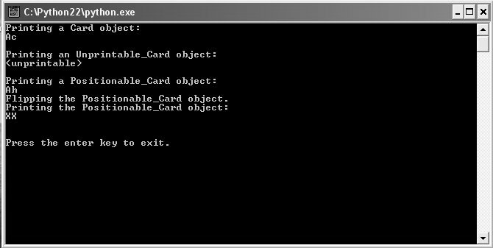
The Playing Cards 3.0 Program
Figure 9.6: Sample run of the Playing Cards program
By overriding __str__(), objects of derived classes print differently.

Slide 34
Creating a Base Class
(Same as before)
class Card(object):
""" A playing card. """
RANKS = ["A", "2", "3", "4", "5", "6", "7",
"8", "9", "10", "J", "Q", "K"]
SUITS = ["c", "d", "h", "s"]
def __init__(self, rank, suit):
self.rank = rank
self.suit = suit
def __str__(self):
rep = self.rank + self.suit
return rep

Slide 35
Overriding Base Class Methods
class Unprintable_Card(Card):
....
def __str__(self):
return "<unprintable>"
Unprintable_Card
Inherits all methods of Card
Overrides inherited method __str__()
Printed object displayed as <unprintable>
A derived class has no effect on a base class

Slide 36
Invoking Base Class Methods
class Positionable_Card(Card):
def __init__(self, rank, suit, face_up = True):
super(Positionable_Card, self).__init__(rank,
suit)
self.is_face_up = face_up
Superclass: Another name for a base class
Card is the superclass of Positionable_Card

Slide 37
Invoking Base Class Methods (continued)
In overridden method, can incorporate inherited method’s functionality
Positionable_Card constructor invokes Card constructor and creates new attribute
super() lets you invoke the method of a superclass
First argument is base class, Positionable_Card
Second is reference to object itself, self
Last is superclass method to call with parameters sent, __init__(rank, suit)

Slide 38
Invoking Base Class Methods (continued)
class Positionable_Card(Card):
def __str__(self):
if self.is_face_up:
rep = super(Positionable_Card, self).__str__()
else:
rep = "XX"
return rep
def flip(self):
self.is_face_up = not self.is_face_up
__str__() invokes superclass __str__() method if card is face up; otherwise, returns "XX"

Slide 39
Using the Derived Classes
card1 = Card("A", "c")
card2 = Unprintable_Card("A", "d")
card3 = Positionable_Card("A", "h")
print card1 # Ac
print card2 # <unprintable>
print card3 # Ah
card3.flip()
print card3 # XX

Slide 40
Understanding Polymorphism
Polymorphism: Aspect of object-oriented programming that allows you to send same message to objects of different classes, related by inheritance, and achieve different but appropriate results for each object
When you invoke __str__() method of Unprintable_Card object, you get different result than when you invoke the __str__() method of a Card object

Slide 41
Creating Modules
Create, use, and even share your own modules
Reuse code
Could reuse the Card, Hand, and Deck classes for different card games
Manage large projects
Professional projects can be hundreds of thousands of lines long
Would be nearly impossible to maintain in one file

Slide 42
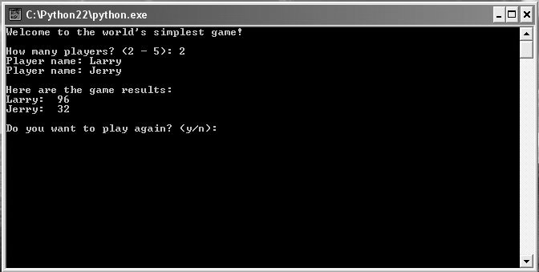
The Simple Game Program
Figure 9.7: Sample run of the Simple Game program
Program uses functions and class from programmer-created module.

Slide 43
Writing Modules
Write module as a collection of related programming components, like functions and classes, in single file
File is just Python file with extension .py
Module imported using filename, just like built-in modules

Slide 44
Writing Modules (continued)
games module is file games.py
class Player(object):
""" A player for a game. """
def __init__(self, name, score = 0):
self.name = name
self.score = score
def __str__(self):
rep = self.name + ":\t" + str(self.score)
return rep

Slide 45
Writing Modules (continued)
def ask_yes_no(question):
"""Ask a yes or no question."""
response = None
while response not in ("y", "n"):
response = raw_input(question).lower()
return response
def ask_number(question, low, high):
"""Ask for a number within a range."""
response = None
while response not in range(low, high):
response = int(raw_input(question))
return response

Slide 46
Writing Modules (continued)
if __name__ == "__main__":
print "You ran module but must 'import' it."
raw_input("\n\nPress the enter key to exit.")
__name__ == "__main__" is true if file is run directly; is false if the file is imported as module
If games.py run directly, message displayed that the file is meant to be imported

Slide 47
Importing Modules
import games, random
Import programmer-created module the same way you import a built-in module

Slide 48
Using Imported Functions and Classes
num = games.ask_number(question = "How many?",
low = 2, high = 5)
...
player = games.Player(name, score)
...
again = games.ask_yes_no("Play again? (y/n): ")
Use imported programmer-created modules the same way as you use imported built-in modules

Slide 49
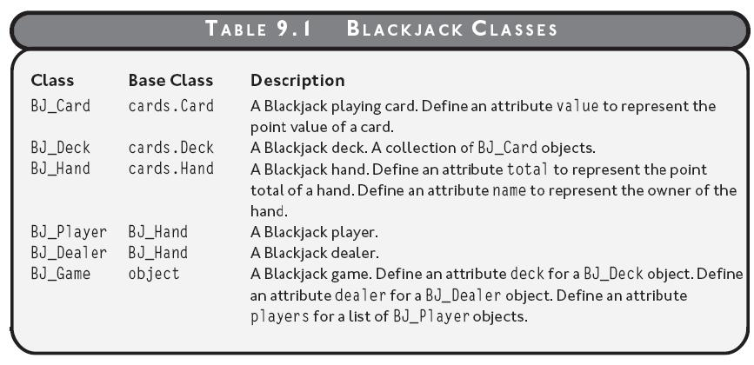
The Blackjack Game - Classes
Table 9.1: Blackjack classes

Slide 50
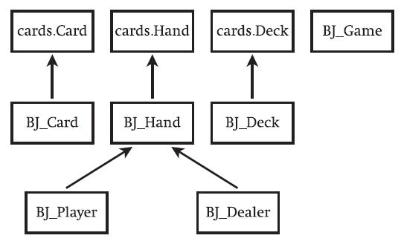
The Blackjack Game – Class Hierarchy
Figure 9.8: Blackjack classes
Inheritance hierarchy of classes for the Blackjack game

Slide 51
The Blackjack Game - Pseudocode
Deal each player and dealer initial two cards
For each player
While the player asks for a hit and the player is not busted
Deal the player an additional card
If there are no players still playing
Show the dealer’s two cards
Otherwise
While the dealer must hit and the dealer is not busted
Deal the dealer an additional card
If the dealer is busted
For each player who is still playing
The player wins

Slide 52
The Blackjack Game – Pseudocode (continued)
Otherwise
For each player who is still playing
If the player’s total is greater than the dealer’s total
The player wins
Otherwise, if the player’s total is less than the dealer’s total
The player loses
Otherwise
The player pushes

Slide 53
Summary
In object-oriented programming, objects can send messages to each other by invoking each other’s methods
Objects can be composed of other objects or have collections of objects
Inheritance is an aspect of object-oriented programming that allows a new class to be based on an existing one where the new class automatically gets (or inherits) all of the methods and attributes of the existing one

Slide 54
Summary (continued)
Inheritance can be used to create a more specialized version of an existing class
A base class is a class upon which another is based; it is inherited from by this other class (the derived class)
A derived class is a class that is based upon another class; it inherits from this other class (a base class)
Superclass is another name for base class

Slide 55
Summary (continued)
A derived class can define new methods and attributes in addition to the ones that it inherits
To override an inherited method is to redefine how the method of a base class works in a derived class
When overriding a method, the new definition can have completely different functionality than the original definition or the new definition can incorporate the functionality of the original

Slide 56
Summary (continued)
The super() function aids you in invoking the method of a superclass
Polymorphism is an aspect of object-oriented programming that allows you to send the same message to objects of different classes, related by inheritance, and achieve different but appropriate results for each object
You can write, import, and even share your own modules

Slide 57
Summary (continued)
You write a module as a collection of related programming components, like functions and classes, in single Python file
Programmer-created modules can be imported the same way that built-in modules are, with an import statement

